Slide 1
hExSCAPE
From Down2 Developers
Release Review

Slide 2
The Team
Dane Reggia
Billy Loveday
Michael Ouille
Gabriel Mayo

Slide 3
Concept:
The idea was create a medieval-themed tactical role-playing game. The game would feature fantasy elements of magic and monsters. The game would initially be developed for the PC.

Slide 4
Broad Types of Actions
Create a navigable game board.
Planned for Sprint 3.
Populate the game board with objects based on a chosen scenario.
Planned for Sprint 5.
Implement combat logic, allowing for interaction between objects.
Planned for Sprint 6.
Implement basic enemy AI, allowing enemies to interact with the player.
Planned for Sprint 7.

Slide 5
Sprint 1

Slide 6
Sprint 1
Product Owner: Billy Loveday
Scrum Master: Dane Reggia
Goals
Set up and practice Unity and C#
Set up collaboration tools
Slack
Trello
Github

Slide 7
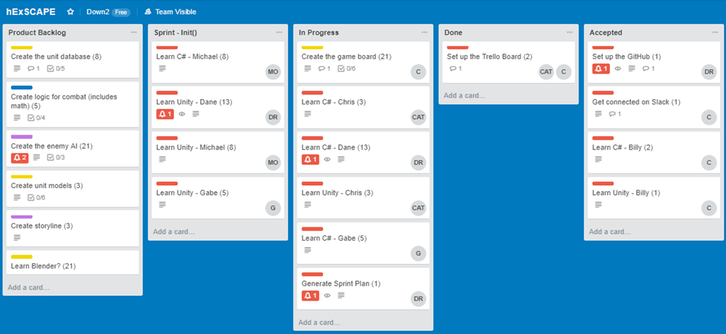
Sprint 1

Slide 8
Sprint 2
Michael was product owner and Chris was scrum master.
Michael, Dane, and Gabe were all tasked to each learn C# and Unity.
Chris’s task was to create base placeholder game engine for game objects.
He successfully wrote classes out and created code for the game objects, but he explained that while the code did work it was not “pretty” and may need some revisions.
Billy’s task was to draft out data diagrams and descriptions of ideal classes he wanted implemented.
He wrote diagrams showing dataflow between his ideal classes. He also wrote brief descriptions for each component.
Tasks for sprint were done, but some not finished.

Slide 9
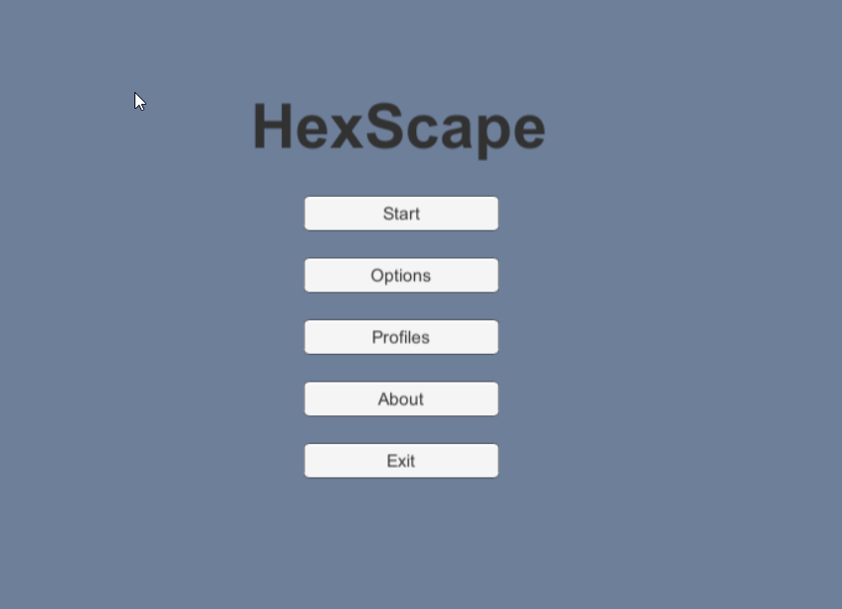
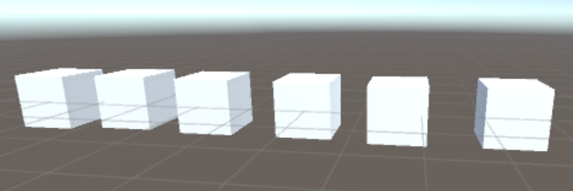
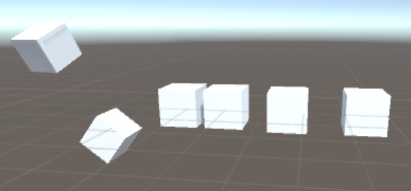
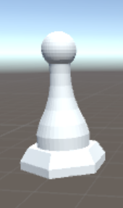
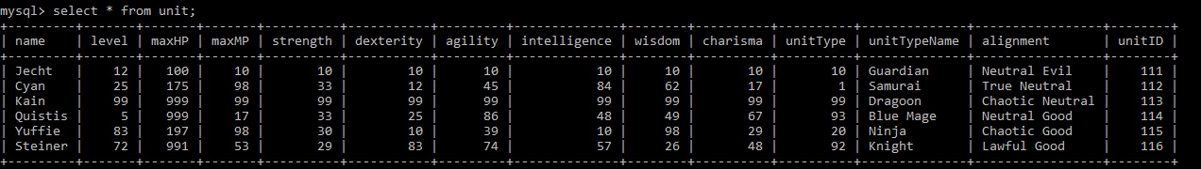
Sprint 3
Spawned the player’s army with some basic representation
Wrote functions that enabled movement around the “board”
Created a MySQL database of units with traits with the plan to select from this database the 6 units for the player army
Created a basic UI that included basic game options like Stop and Start
Rendered representations of units using Blender software (chess pieces)
Notes:
Represented with cubes (maybe create a picture of cubes again and show unique troubles with them crashing into each other
Attached movement to arrow keys just for learning. There was no board yet at this point
Tell how we thought we wanted a real database at this point in development because, what did we know about games anyway?
Make sure to show a picture of michaels interface
Grab a chess piece or two to show

Slide 10
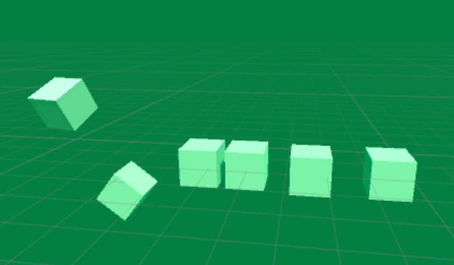
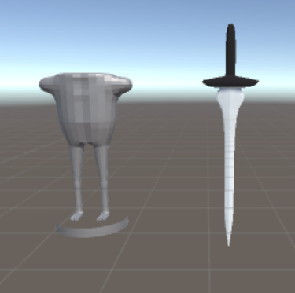
Sprint 4
Realized that integration was going to be difficult
Integrated the UI with the army spawning code…but failed to turn the army into rendered units
Experienced difficulty integrating the hex map with the integrated UI + army code
Learned at least 10 ways not to create a board/snap objects to a board
Created more units in Blender
Succeeded in creating user profile form, but saving the user data was troublesome
Successful in pulling unit attributes from database but began
to realize perhaps a traditional DB was not the way to go.
Notes:
Show a messed up picture of board turned green
A picture of one of billys units

Slide 11
Sprint 5
Product Owner: Gabe Mayo
Scrum Master: Michael Ouille
Goals
Dane: Movement functionality
Michael: Creating and saving user profiles
Gabe: Combat logic
Billy: Modeling and intro video
Chris: State controller

Slide 12
Sprint 5
Dane’s Accomplishments
Integrated Billy’s board code and his own.
Implemented Billy’s models and floating animation.
Spawned pieces on the board using Billy’s models.
Enabled movement functionality.

Slide 13
Sprint 5

Slide 14
Sprint 5
Michael’s Accomplishments
Completed GUI for profile completion form and profile view form.
Wrote scripts to save profile data to files.

Slide 15
Sprint 5

Slide 16
Sprint 5
Billy’s Accomplishments
Rendered animation videos.
Created the town model.

Slide 17
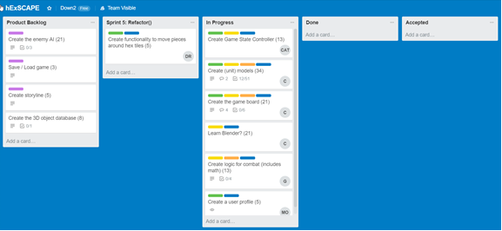
Sprint 5

Slide 18
Sprint 6
Michael: Finished mapping out placement of HUD assets.
Gabe: Worked on some of the combat logic
Dane: Moved unit models around the game board hexly – each piece moves from the center of one hexagon to the center of another.
Billy: Became a Blender Magician

Slide 19
Sprint 6
Billy: Resolved a number of issues with Blender animations rendering properly for the introduction. Introduction for the game has been completed.

Slide 20
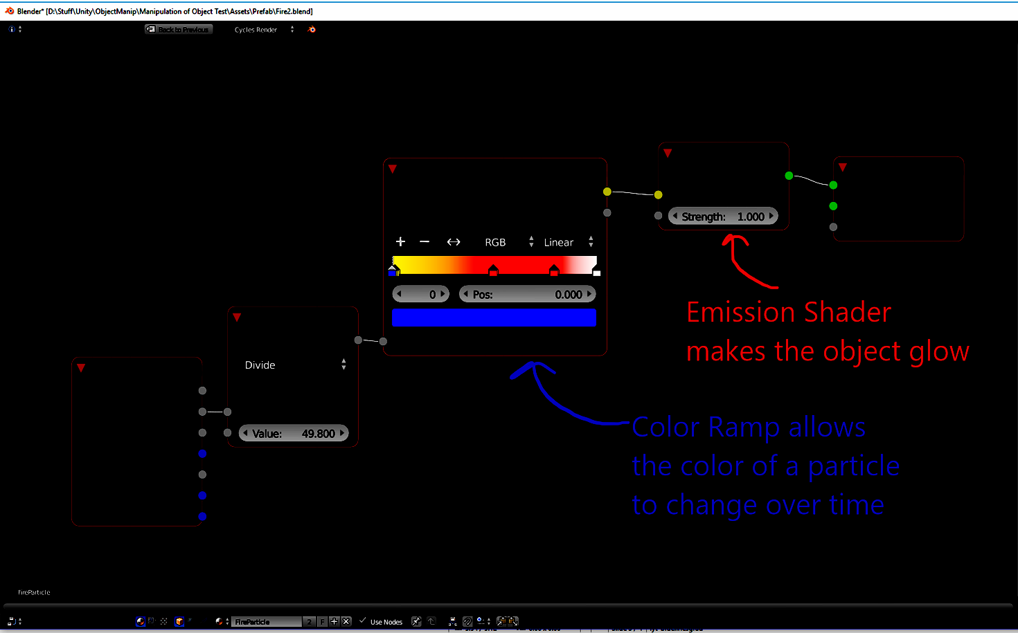

Slide 21
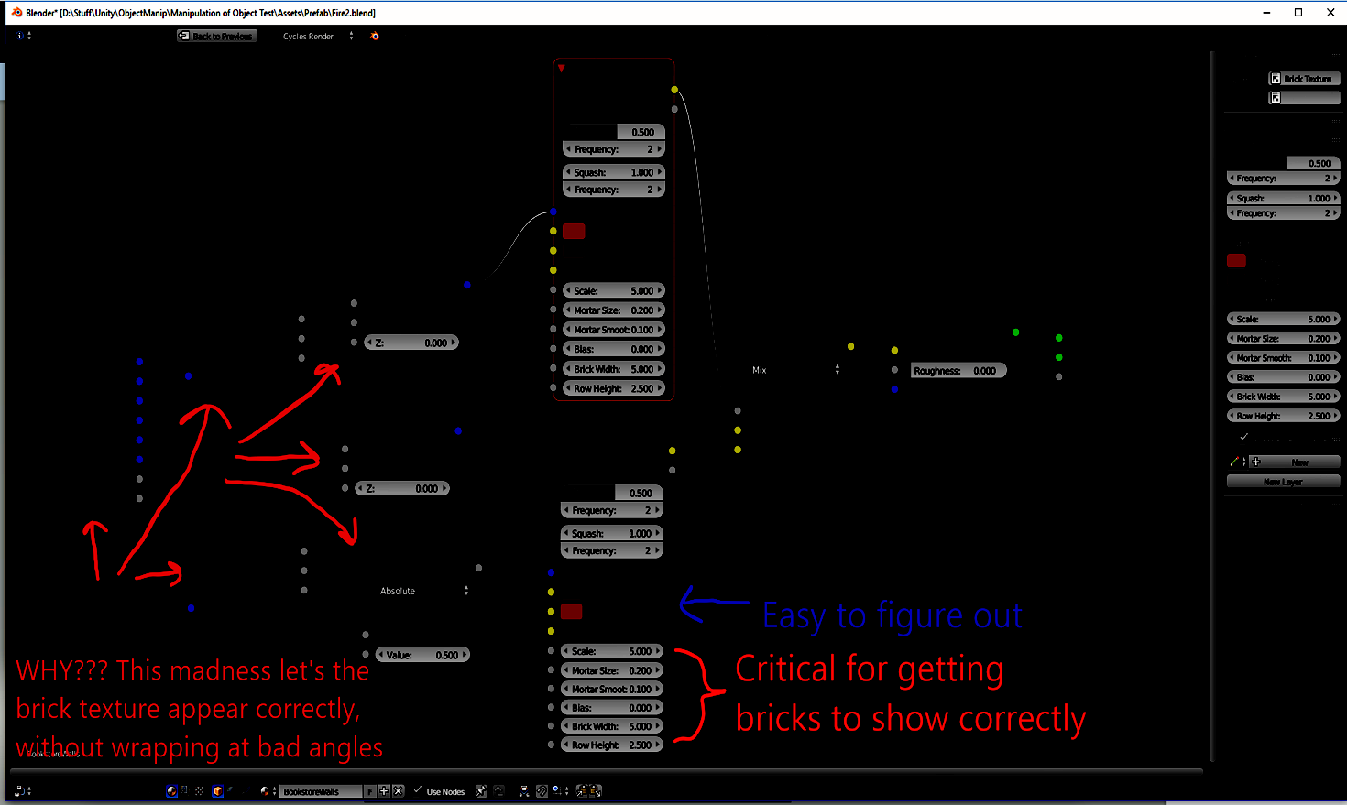

Slide 22
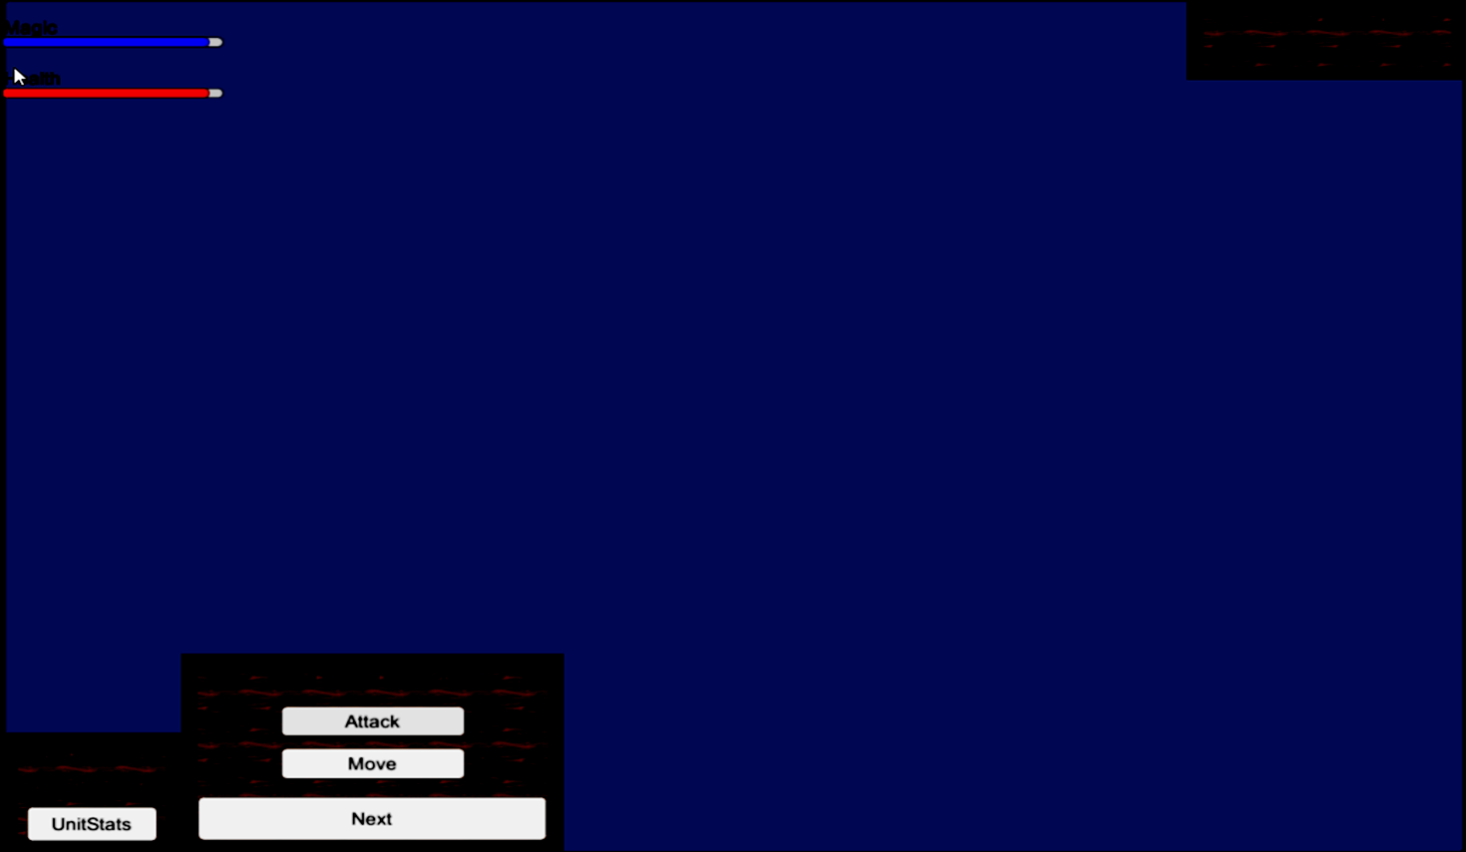

Slide 23
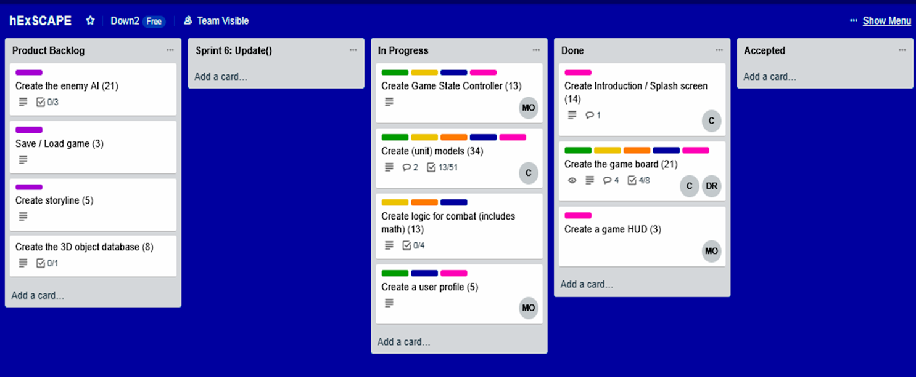

Slide 24
Sprint 7
Dane was scrum master and Billy was product owner.
Gabe’s goal for the sprint was to flesh out the attack logic to select targets.
He scripted the code, but had issues getting it to work. The event system bottlenecked him.
Michael’s task was to clean up the HUD assets and implement code for them.
HUD was successfully cleaned based off group feedback, and code was scripted/tested.
Dane’s task was to spawn enemies of a different color and give enemies movement.
Enemies successfully spawn randomly on the board with their own unique models.
Billy’s task for the week was to unify the project and create more 3D models...
Sprint had some roadblocks and some successes.

Slide 25
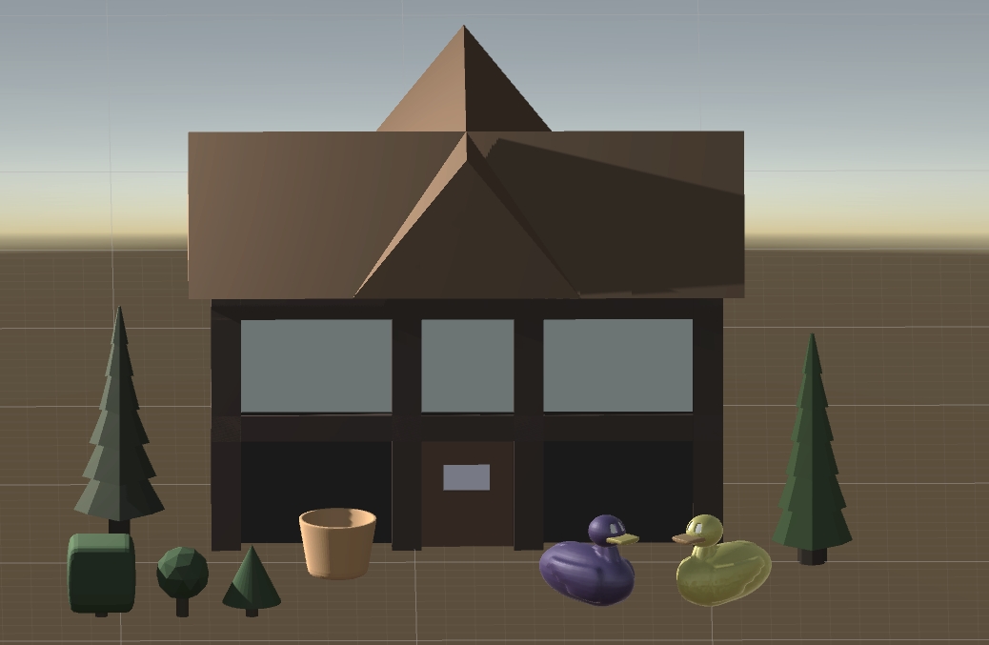
Final Product Features
Michael presents but everyone contributes

Slide 26
Final Product Features
A spawned player army of white “archers” that can move in 6 directions to adjacent tiles, but not onto an occupied tile or off the board.
A randomly spawned group of enemies
A hex map with plains, a lake, grass, wasteland, and mountain scenery in the background
A floating sword!

Slide 27
Features Yet To Come for the Holiday Release
All of them

